Slide 1
Search Engines
Information Retrieval in Practice
All slides ©Addison Wesley, 2008

Slide 2
Classification and Clustering
Classification and clustering are classical pattern recognition / machine learning problems
Classification
  Asks “what class does this item belong to?”
  Supervised learning task
Clustering
  Asks “how can I group this set of items?”
  Unsupervised learning task
Items can be documents, queries, emails, entities, images, etc.
Useful for a wide variety of search engine tasks

Slide 3
Classification
Classification is the task of automatically applying labels to items
Useful for many search-related tasks
  Spam detection
  Sentiment classification
  Online advertising
Two common approaches
  Probabilistic
  Geometric

Slide 4
How to Classify?
How do humans classify items?
For example, suppose you had to classify the “healthiness” of a food
  Identify set of features indicative of health
    fat, cholesterol, sugar, sodium, etc.
  Extract features from foods
    Read nutritional facts, chemical analysis, etc.
  Combine evidence from the features into a hypothesis
    Add health features together to get “healthiness factor”
  Finally, classify the item based on the evidence
    If “healthiness factor” is above a certain value, then deem it healthy

Slide 5
Ontologies
Ontology is a labeling or categorization scheme
Examples
  Binary (spam, not spam)
  Multi-valued (red, green, blue)
  Hierarchical (news/local/sports)
Different classification tasks require different ontologies

Slide 6
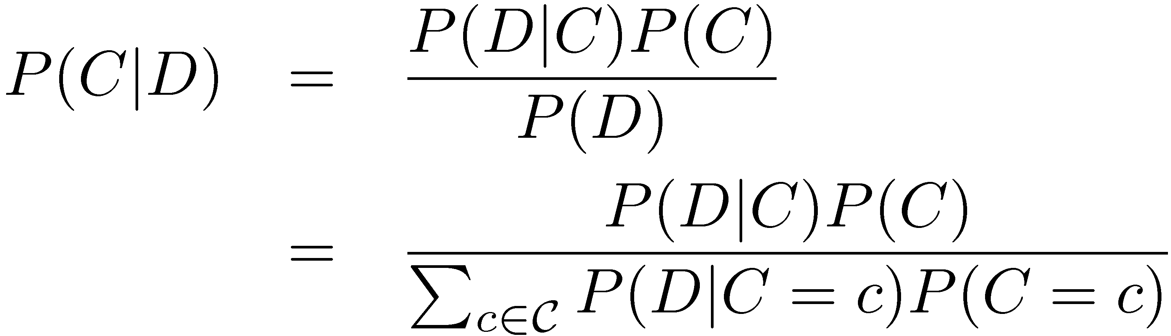
Naïve Bayes Classifier
Probabilistic classifier based on Bayes’ rule:
C is a random variable corresponding to the class
D is a random variable corresponding to the input (e.g. document)

Slide 7
Probability 101: Random Variables
Random variables are non-deterministic
  Can be discrete (finite number of outcomes) or continues
  Model uncertainty in a variable
P(X = x) means “the probability that random variable X takes on value x”
Example:
  Let X be the outcome of a coin toss
  P(X = heads) = P(X = tails) = 0.5
Example: Y = 5 - 2X
  If X is random, then Y is random
  If X is deterministic then Y is also deterministic
    Note: “Deterministic” just means P(X = x) = 1.0!

Slide 8
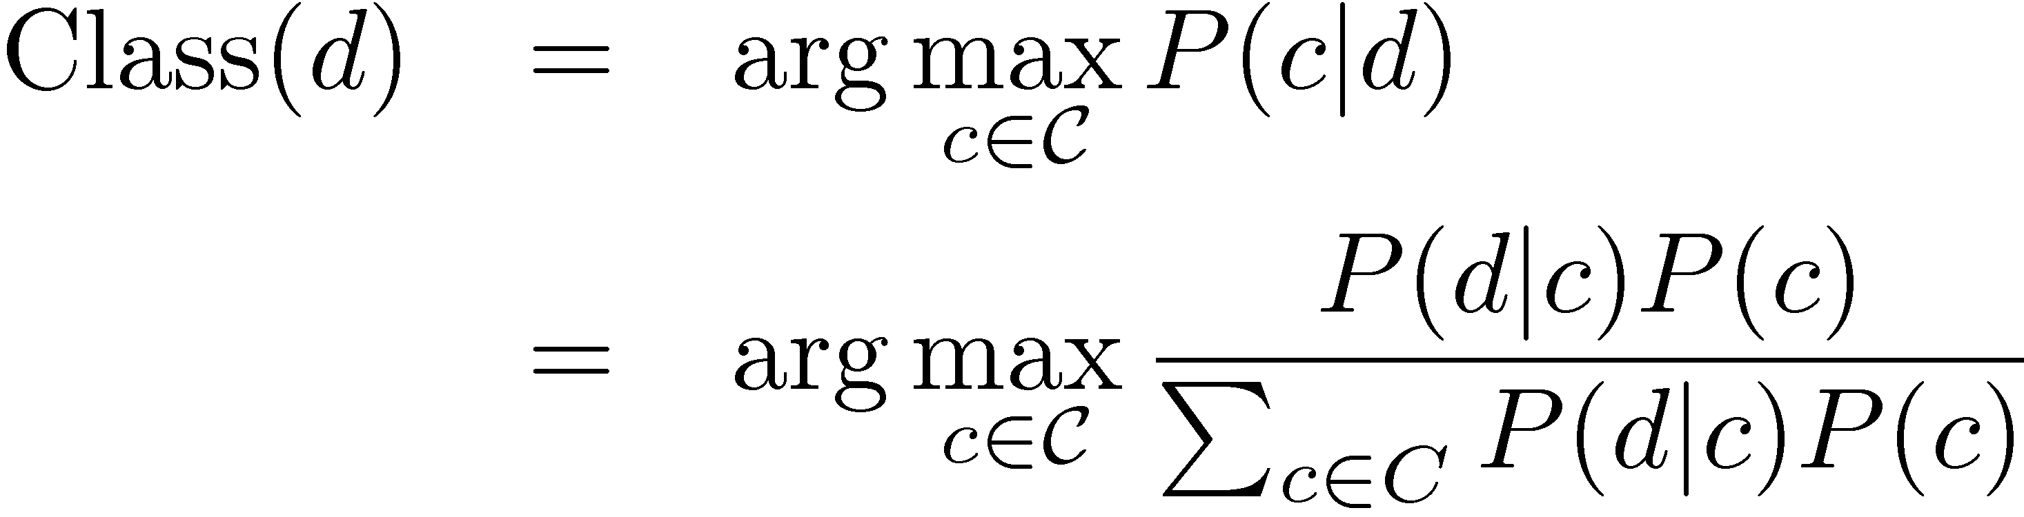
Naïve Bayes Classifier
Documents are classified according to:
Must estimate P(d | c) and P(c)
  P(c) is the probability of observing class c
  P(d | c) is the probability that document d is observed given the class is known to be c

Slide 9
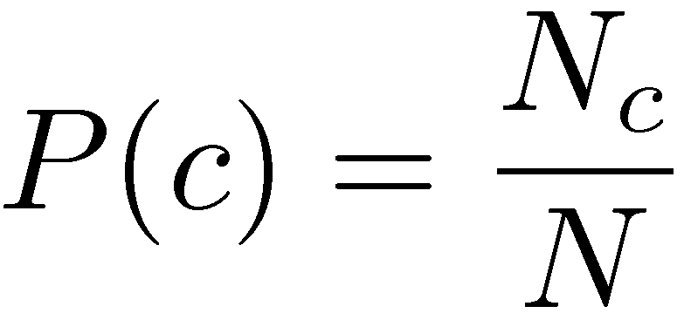
Estimating P(c)
P(c) is the probability of observing class c
Estimated as the proportion of training documents in class c:
N_{c} is the number of training documents in class c
N is the total number of training documents

Slide 10
Estimating P(d | c)
P(d | c) is the probability that document d is observed given the class is known to be c
Estimate depends on the event space used to represent the documents
What is an event space?
  The set of all possible outcomes for a given random variable
  For a coin toss random variable the event space is S = {heads, tails}

Slide 11
Multiple Bernoulli Event Space
Documents are represented as binary vectors
  One entry for every word in the vocabulary
  Entry i = 1 if word i occurs in the document and is 0 otherwise
Multiple Bernoulli distribution is a natural way to model distributions over binary vectors
Same event space as used in the classical probabilistic retrieval model

Slide 12
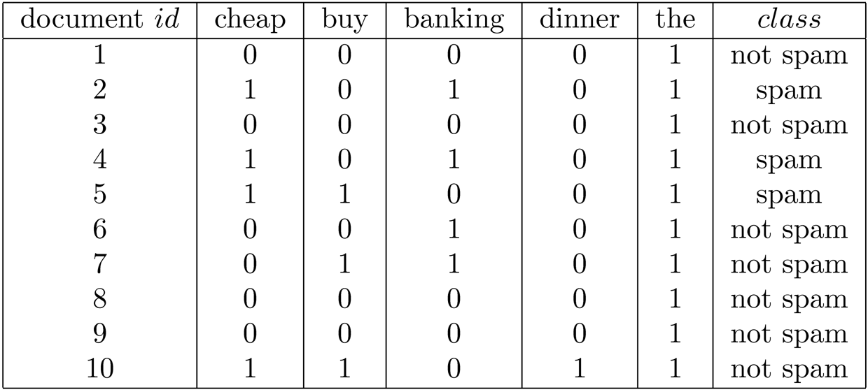
Multiple Bernoulli Document Representation

Slide 13
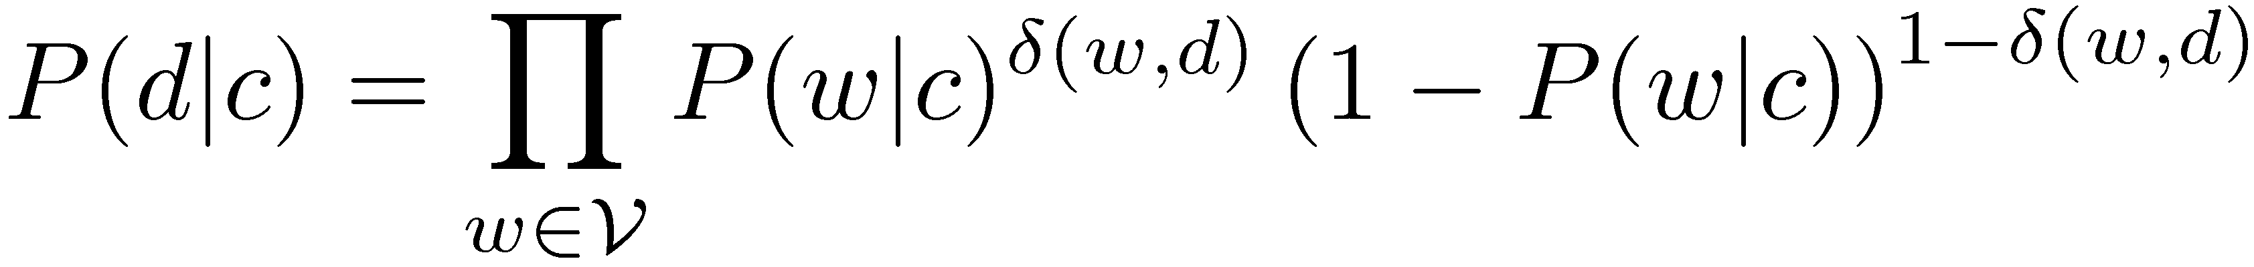
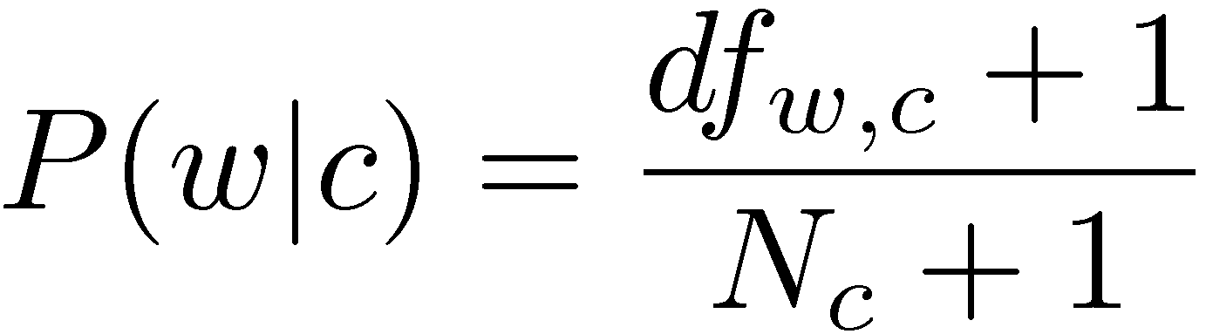
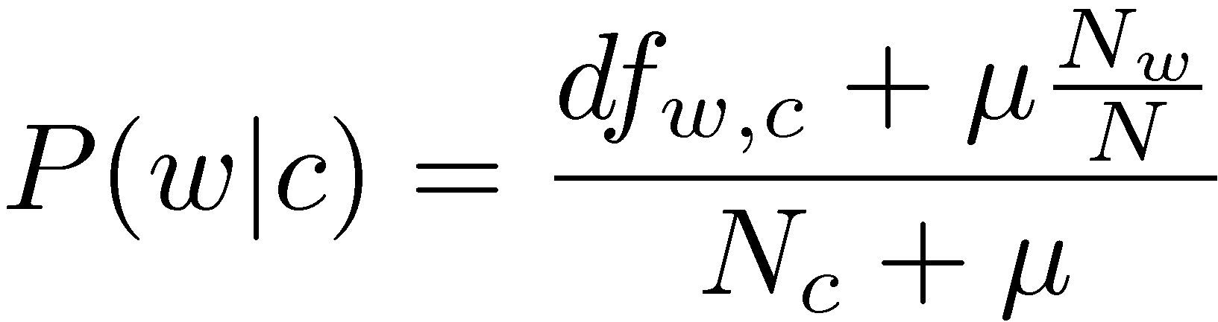
Multiple-Bernoulli: Estimating P(d | c)
P(d | c) is computed as:
Laplacian smoothed estimate:
Collection smoothed estimate:

Slide 14
Multinomial Event Space
Documents are represented as vectors of term frequencies
  One entry for every word in the vocabulary
  Entry i = number of times that term i occurs in the document
Multinomial distribution is a natural way to model distributions over frequency vectors
Same event space as used in the language modeling retrieval model

Slide 15
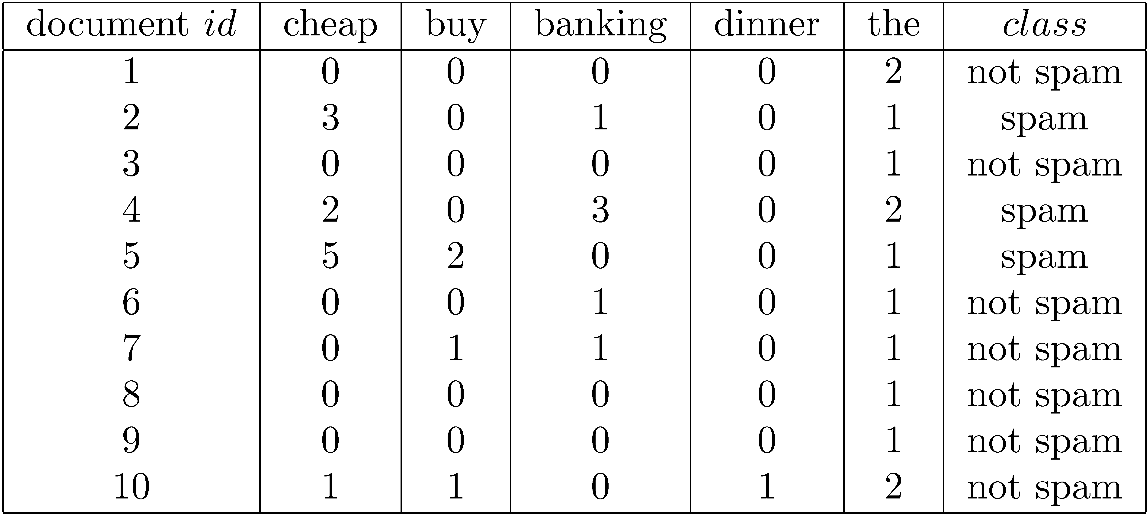
Multinomial Document Representation

Slide 16
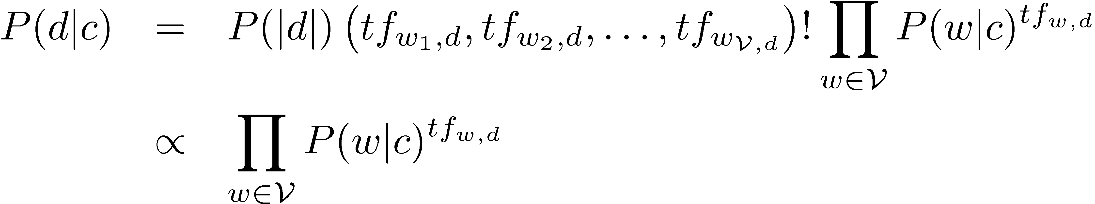
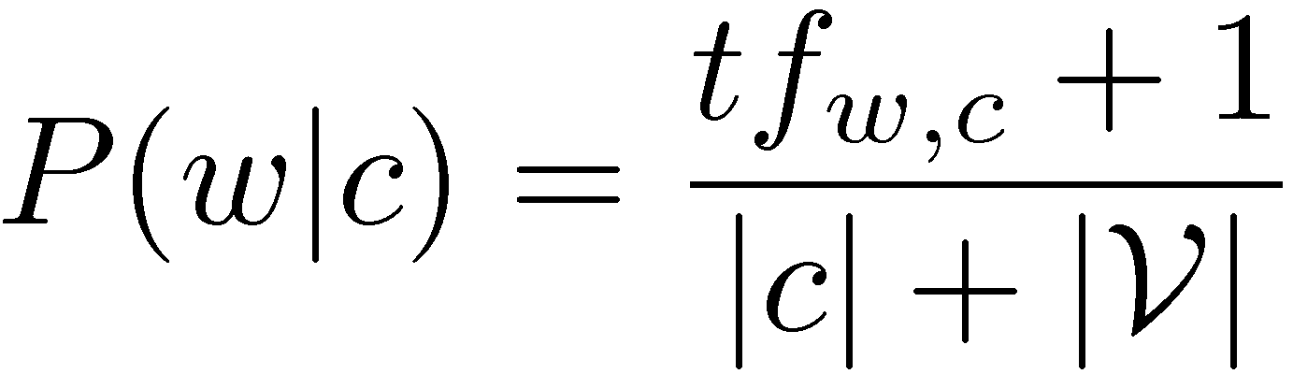
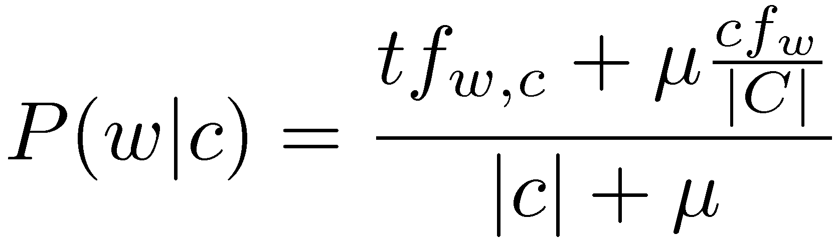
Multinomial: Estimating P(d | c)
P(d | c) is computed as:
Laplacian smoothed estimate:
Collection smoothed estimate:

Slide 17
Support Vector Machines
Based on geometric principles
Given a set of inputs labeled ‘+’ and ‘-’, find the “best” hyperplane that separates the ‘+’s and ‘-’s
Questions
  How is “best” defined?
  What if no hyperplane exists such that the ‘+’s and ‘-’s can be perfectly separated?

Slide 18
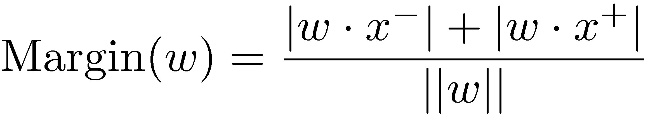
“Best” Hyperplane?
First, what is a hyperplane?
  A generalization of a line to higher dimensions
  Defined by a vector w
With SVMs, the best hyperplane is the one with the maximum margin
If x⁺ and x⁻ are the closest ‘+’ and ‘-’ inputs to the hyperplane, then the margin is:

Slide 19
Support Vector Machines
+
+
–
+
–
+
–
+
Margin
–
+
–
+
+
–
–
+
Hyperplane
–
–
–
+

Slide 20
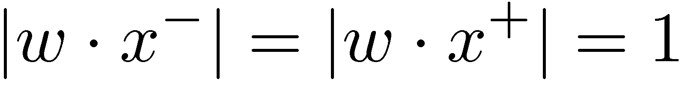
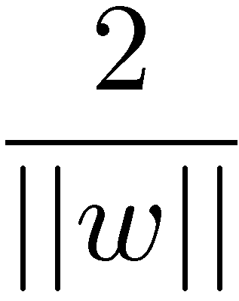

“Best” Hyperplane?
It is typically assumed that ,
which does not change the solution to the problem
Thus, to find the hyperplane with the largest margin, we must maximize .
This is equivalent to minimizing .

Slide 21
Separable vs. Non-Separable Data
+
+
–
–
+
+
–
+
+
–
+
–
+
–
+
–
–
–
+
+
+
–
+
–
+
–
–
+
–
+
–
–
+
+
+
+
–
–
–
–
Separable
Non-Separable

Slide 22
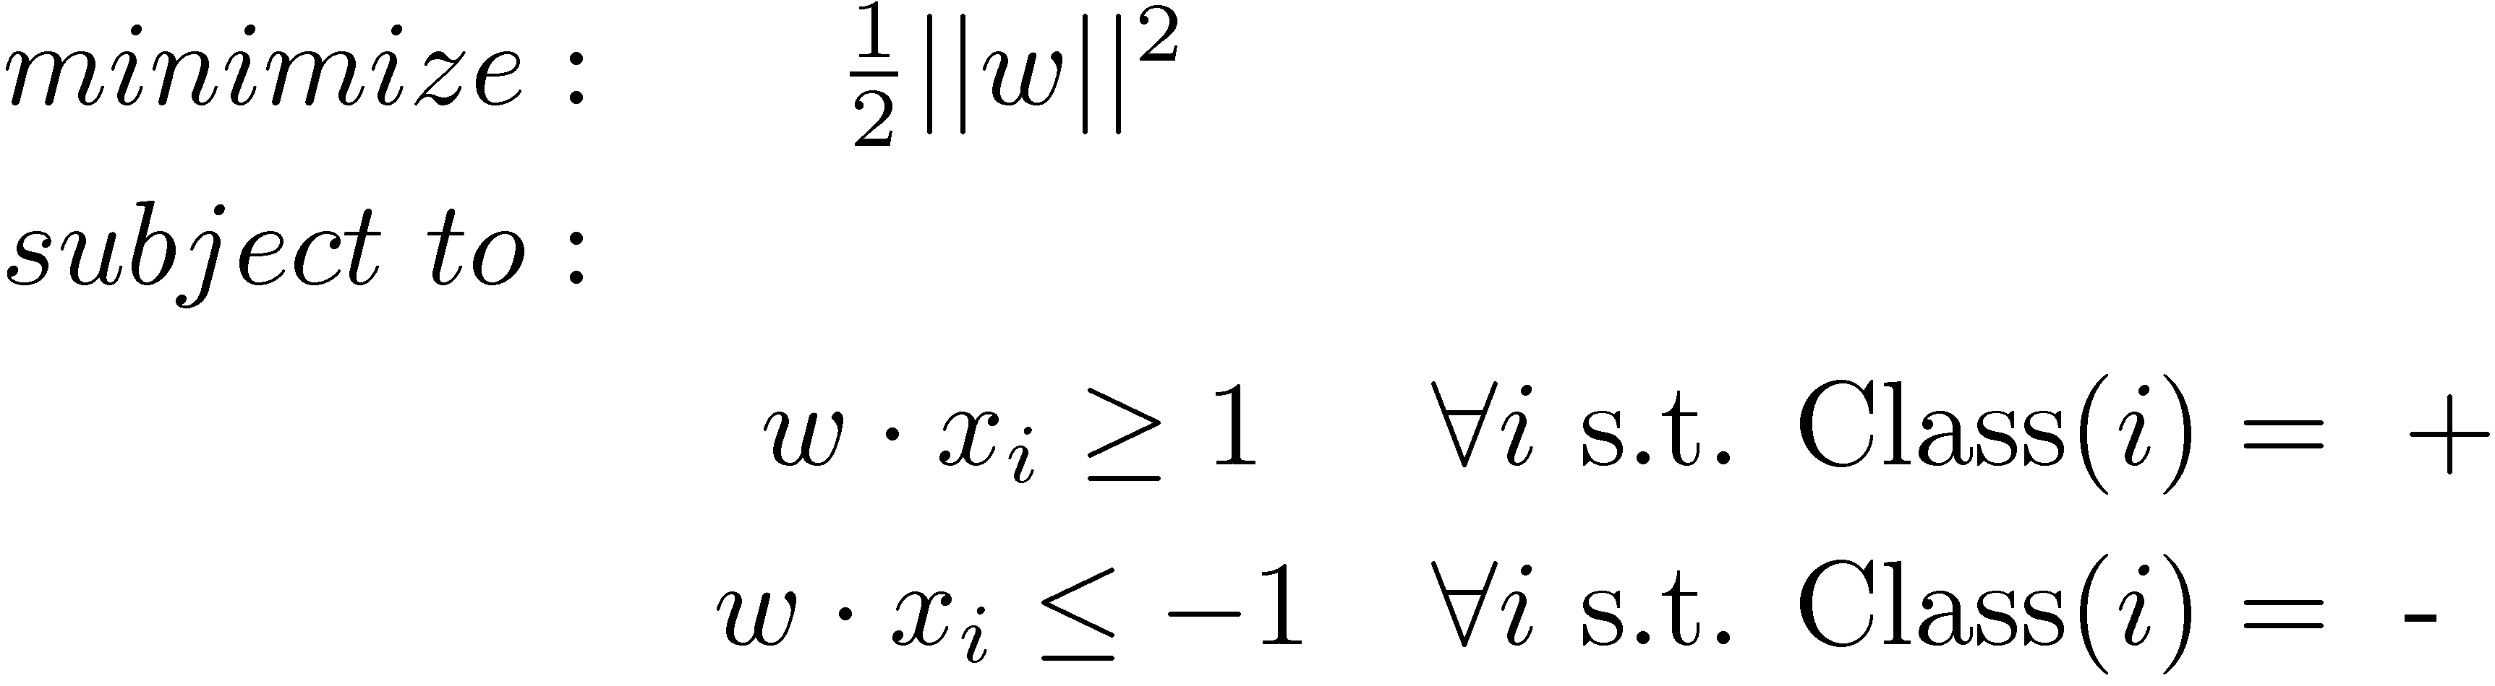
Linear Separable Case
In math:
In English:
  Find the largest margin hyperplane that separates the ‘+’s and ‘-’s

Slide 23
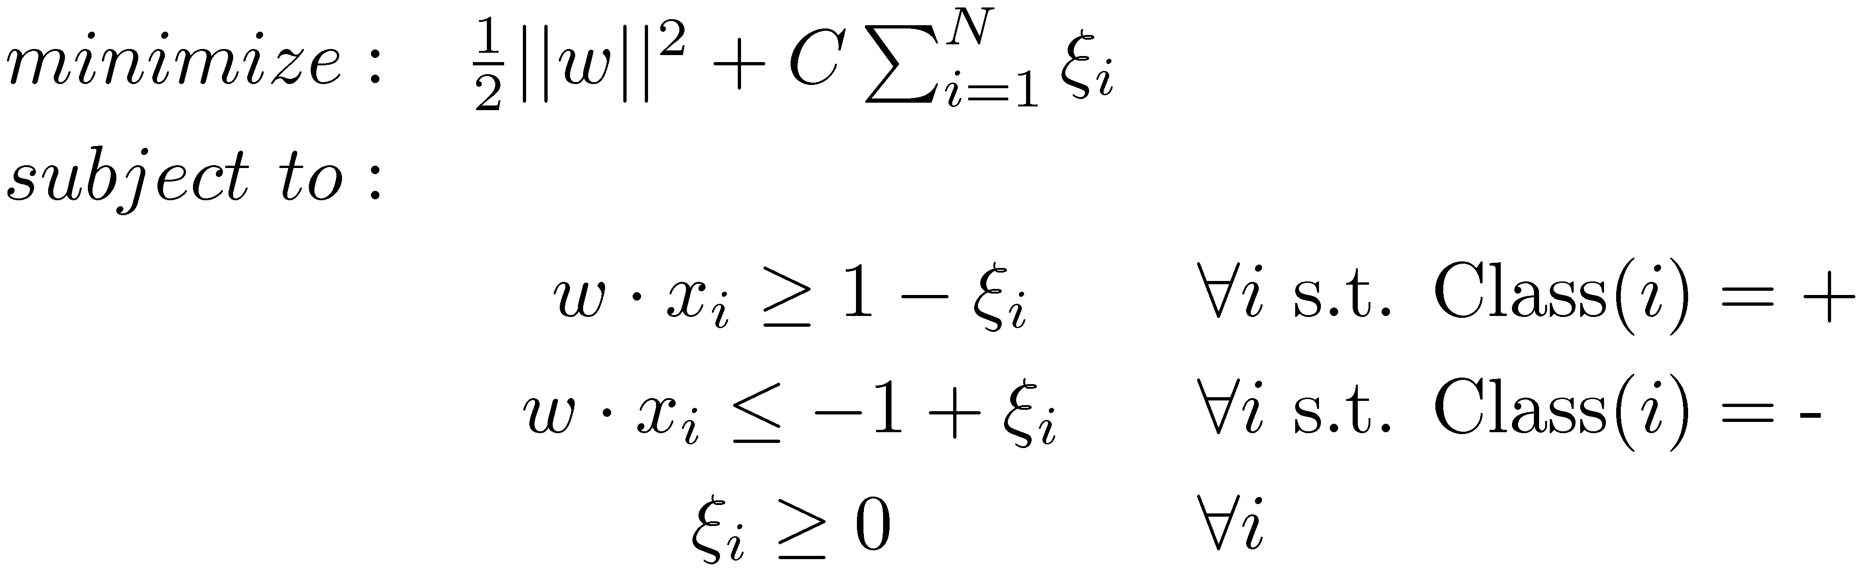
Linearly Non-Separable Case
In math:
In English:
  ξ_{i} denotes how misclassified instance i is
  Find a hyperplane that has a large margin and lowest misclassification cost

Slide 24
The Kernel Trick
Linearly non-separable data may become linearly separable if transformed, or mapped, to a higher dimension space
Computing vector math (i.e., dot products) in very high dimensional space is costly
The kernel trick allows very high dimensional dot products to be computed efficiently
Allows inputs to be implicitly mapped to high (possibly infinite) dimensional space with little computational overhead

Slide 25
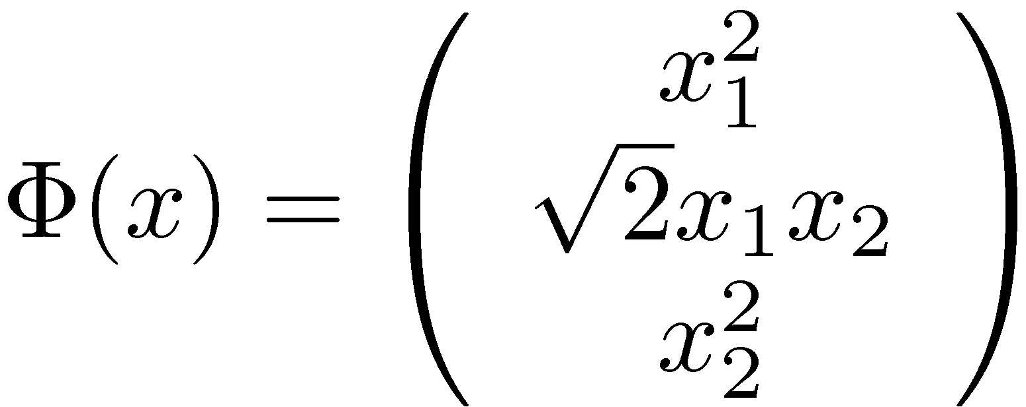
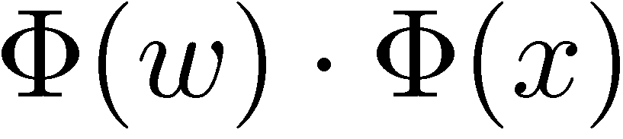
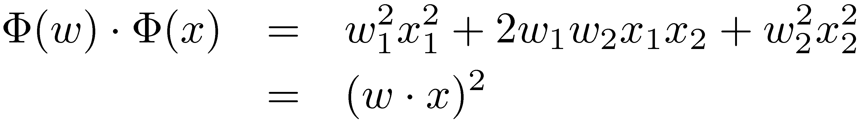
Kernel Trick Example
The following function maps 2-vectors to 3-vectors:
Standard way to compute is to map the inputs and compute the dot product in the higher dimensional space
However, the dot product can be done entirely in the original 2-dimensional space:

Slide 26
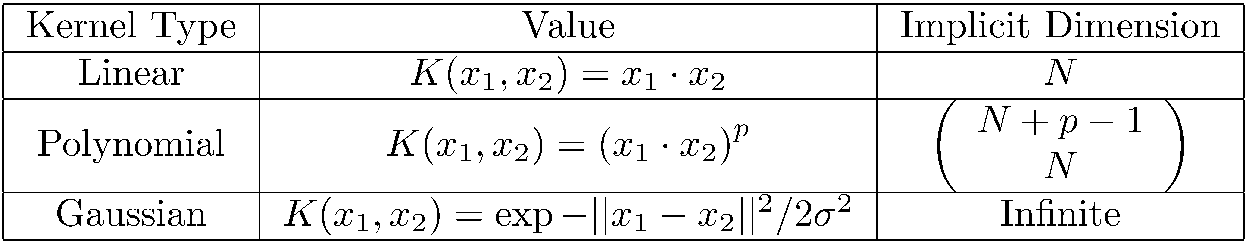
Common Kernels
The previous example is known as the polynomial kernel (with p = 2)
Most common kernels are linear, polynomial, and Gaussian
Each kernel performs a dot product in a higher implicit dimensional space

Slide 27
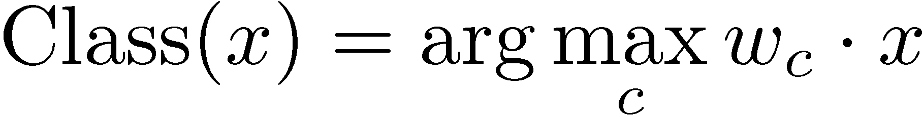
Non-Binary Classification with SVMs
One versus all
  Train “class c vs. not class c” SVM for every class
  If there are K classes, must train K classifiers
  Classify items according to:
One versus one
  Train a binary classifier for every pair of classes
  Must train K(K-1)/2 classifiers
  Computationally expensive for large values of K

Slide 28
SVM Tools
Solving SVM optimization problem is not straightforward
Many good software packages exist
  SVM-Light
  LIBSVM
  R library
  Matlab SVM Toolbox

Slide 29
Evaluating Classifiers
Common classification metrics
  Accuracy (precision at rank 1)
  Precision
  Recall
  F-measure
  ROC curve analysis
Differences from IR metrics
  “Relevant” replaced with “classified correctly”
  Microaveraging more commonly used

Slide 30
Classes of Classifiers
Types of classifiers
  Generative (Naïve-Bayes)
  Discriminative (SVMs)
  Non-parametric (nearest neighbor)
Types of learning
  Supervised (Naïve-Bayes, SVMs)
  Semi-supervised (Rocchio, relevance models)
  Unsupervised (clustering)

Slide 31
Generative vs. Discriminative
Generative models
  Assumes documents and classes are drawn from joint distribution P(d, c)
  Typically P(d, c) decomposed to P(d | c) P(c)
  Effectiveness depends on how P(d, c) is modeled
  Typically more effective when little training data exists
Discriminative models
  Directly model class assignment problem
  Do not model document “generation”
  Effectiveness depends on amount and quality of training data

Slide 32
Naïve Bayes Generative Process
Class 1
Class 2
Class 3
Generate class according to P(c)
Class 2
Generate document according to P(d|c)

Slide 33
Nearest Neighbor Classification
–
–
+
–
+
–
–
–
–
–
–
+
+
+
+
–
–
+
–
+
+
–
–
+
+
+
–
–
–
–
+
+
+
+
–
–
+
–
+
–
+
+
+
–
–
+
+
–
+
–
–
+
+
–
–
+
+
+
–
+
+
–
–
+
–
–

Slide 34
Feature Selection
Document classifiers can have a very large number of features
  Not all features are useful
  Excessive features can increase computational cost of training and testing
Feature selection methods reduce the number of features by choosing the most useful features

Slide 35
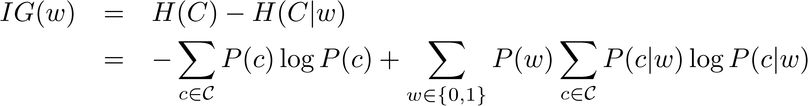
Information Gain
Information gain is a commonly used feature selection measure based on information theory
  It tells how much “information” is gained if we observe some feature
Rank features by information gain and then train model using the top K (K is typically small)
The information gain for a Multiple-Bernoulli Naïve Bayes classifier is computed as:

Slide 36
Classification Applications
Classification is widely used to enhance search engines
Example applications
  Spam detection
  Sentiment classification
  Semantic classification of advertisements
  Many others not covered here!

Slide 37
Spam, Spam, Spam
Classification is widely used to detect various types of spam
There are many types of spam
  Link spam
    Adding links to message boards
    Link exchange networks
    Link farming
  Term spam
    URL term spam
    Dumping
    Phrase stitching
    Weaving

Slide 38
Spam Example

Slide 39
Spam Detection
Useful features
  Unigrams
  Formatting (invisible text, flashing, etc.)
  Misspellings
  IP address
Different features are useful for different spam detection tasks
Email and web page spam are by far the most widely studied, well understood, and easily detected types of spam

Slide 40
Example Spam Assassin Output

Slide 41
Sentiment
Blogs, online reviews, and forum posts are often opinionated
Sentiment classification attempts to automatically identify the polarity of the opinion
  Negative opinion
  Neutral opinion
  Positive opinion
Sometimes the strength of the opinion is also important
  “Two stars” vs. “four stars”
  Weakly negative vs. strongly negative

Slide 42
Classifying Sentiment
Useful features
  Unigrams
  Bigrams
  Part of speech tags
  Adjectives
SVMs with unigram features have been shown to be outperform hand built rules

Slide 43
Sentiment Classification Example

Slide 44
Classifying Online Ads
Unlike traditional search, online advertising goes beyond “topical relevance”
A user searching for ‘tropical fish’ may also be interested in pet stores, local aquariums, or even scuba diving lessons
These are semantically related, but not topically relevant!
We can bridge the semantic gap by classifying ads and queries according to a semantic hierarchy

Slide 45
Semantic Classification
Semantic hierarchy ontology
  Example: Pets / Aquariums / Supplies
Training data
  Large number of queries and ads are manually classified into the hierarchy
Nearest neighbor classification has been shown to be effective for this task
Hierarchical structure of classes can be used to improve classification accuracy

Slide 46
Semantic Classification
Aquariums
Fish
Supplies
Rainbow Fish Resources
Discount Tropical Fish Food
Feed your tropical fish a gourmet diet for just pennies a day!
www.cheapfishfood.com
Web Page
Ad

Slide 47
Clustering
A set of unsupervised algorithms that attempt to find latent structure in a set of items
Goal is to identify groups (clusters) of similar items
Suppose I gave you the shape, color, vitamin C content, and price of various fruits and asked you to cluster them
  What criteria would you use?
  How would you define similarity?
Clustering is very sensitive to how items are represented and how similarity is defined!

Slide 48
Clustering
General outline of clustering algorithms
  Decide how items will be represented (e.g., feature vectors)
  Define similarity measure between pairs or groups of items (e.g., cosine similarity)
  Determine what makes a “good” clustering
  Iteratively construct clusters that are increasingly “good”
  Stop after a local/global optimum clustering is found
Steps 3 and 4 differ the most across algorithms

Slide 49
Hierarchical Clustering
Constructs a hierarchy of clusters
  The top level of the hierarchy consists of a single cluster with all items in it
  The bottom level of the hierarchy consists of N
  (# items) singleton clusters
Two types of hierarchical clustering
  Divisive (“top down”)
  Agglomerative (“bottom up”)
Hierarchy can be visualized as a dendogram

Slide 50
Example Dendrogram
M
L
K
J
I
H
A
B
C
D
E
F
G

Slide 51
Divisive and Agglomerative Hierarchical Clustering
Divisive
  Start with a single cluster consisting of all of the items
  Until only singleton clusters exist…
    Divide an existing cluster into two new clusters
Agglomerative
  Start with N (# items) singleton clusters
  Until a single cluster exists…
    Combine two existing cluster into a new cluster
How do we know how to divide or combined clusters?
  Define a division or combination cost
  Perform the division or combination with the lowest cost

Slide 52
Divisive Hierarchical Clustering
A
A
D
E
D
E
G
G
B
B
F
F
C
C
A
A
D
E
D
E
G
G
B
B
F
F
C
C

Slide 53
Agglomerative Hierarchical Clustering
A
A
D
E
D
E
G
G
B
B
F
F
C
C
A
A
D
E
D
E
G
G
B
B
F
F
C
C

Slide 54
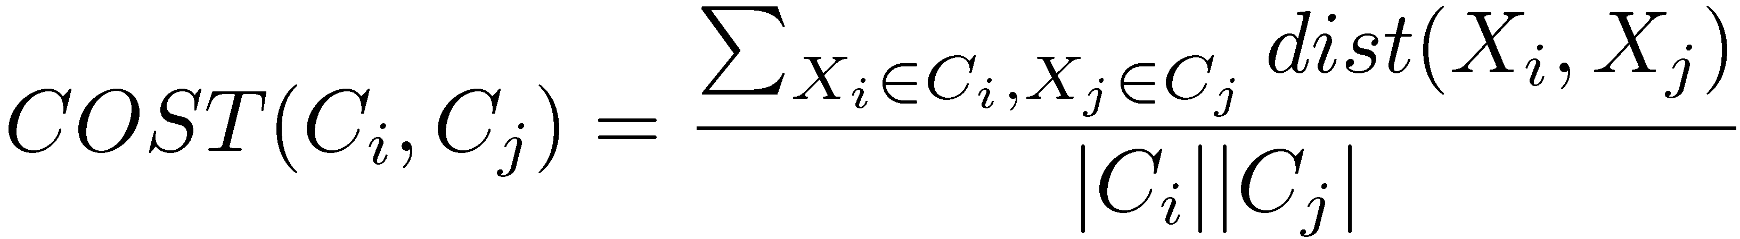
Clustering Costs
Single linkage
Complete linkage
Average linkage
Average group linkage

Slide 55
Clustering Strategies
Single Linkage
Complete Linkage
A
A
D
E
D
E
G
G
B
B
F
F
C
C
Average Linkage
Average Group Linkage
A
μ
D
E
μ
G
B
μ
F
μ
C

Slide 56
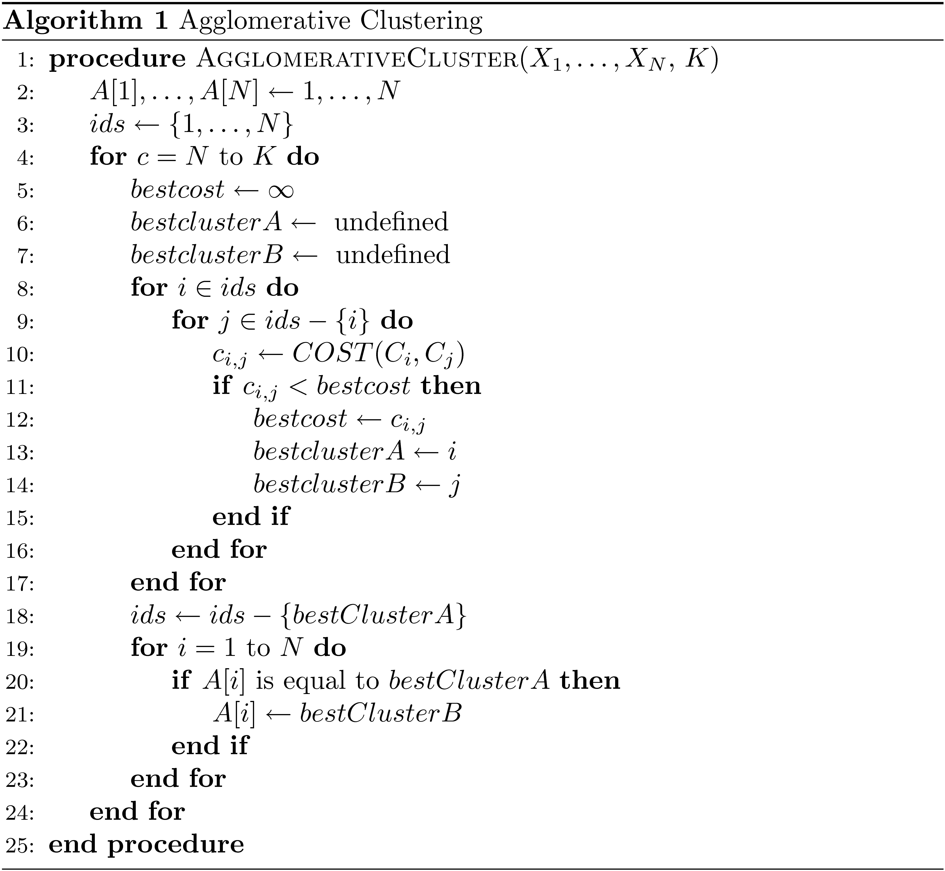
Agglomerative Clustering Algorithm

Slide 57
K-Means Clustering
Hierarchical clustering constructs a hierarchy of clusters
K-means always maintains exactly K clusters
  Clusters represented as centroids (“center of mass”)
Basic algorithm:
  Step 0: Choose K cluster centroids
  Step 1: Assign points to closet centroid
  Step 2: Recompute cluster centroids
  Step 3: Goto 1
Tends to converge quickly
Can be sensitive to choice of initial centroids
Must choose K!

Slide 58
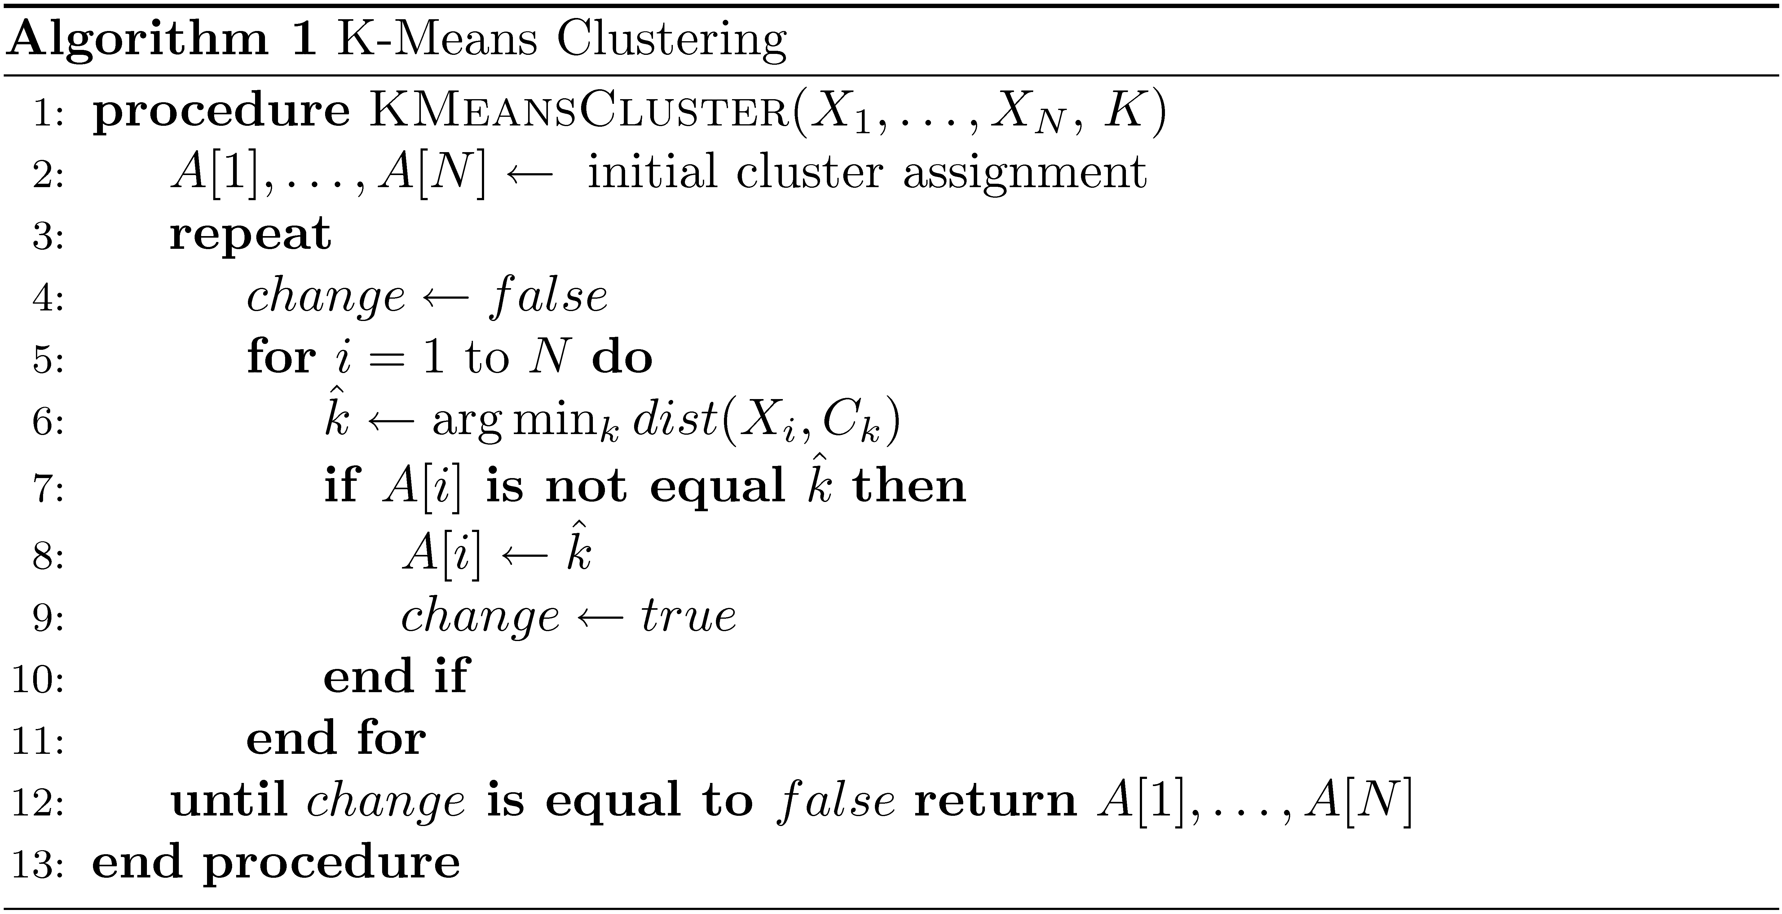
K-Means Clustering Algorithm

Slide 59
K-Nearest Neighbor Clustering
Hierarchical and K-Means clustering partition items into clusters
  Every item is in exactly one cluster
K-Nearest neighbor clustering forms one cluster per item
  The cluster for item j consists of j and j’s K nearest neighbors
  Clusters now overlap

Slide 60
5-Nearest Neighbor Clustering
A
A
A
A
D
A
D
A
D
D
C
B
B
C
C
B
C
D
B
D
B
B
C
C

Slide 61
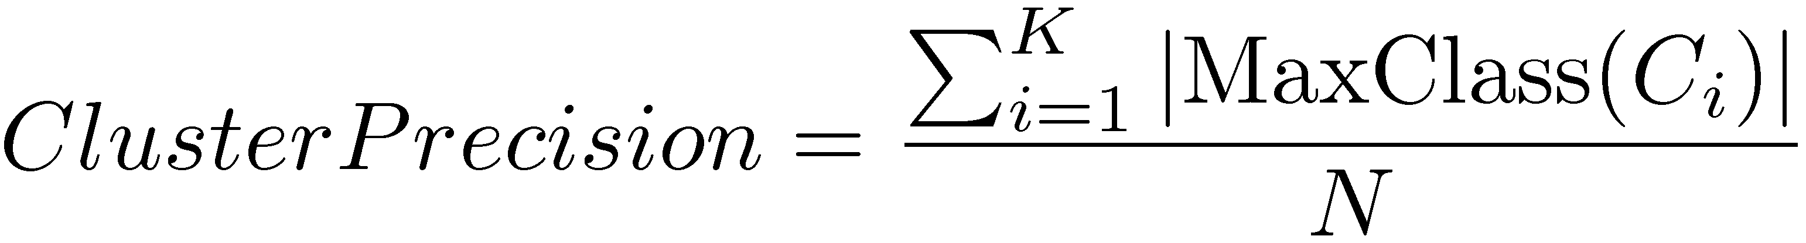
Evaluating Clustering
Evaluating clustering is challenging, since it is an unsupervised learning task
If labels exist, can use standard IR metrics, such as precision and recall
If not, then can use measures such as “cluster precision”, which is defined as:
Another option is to evaluate clustering as part of an end-to-end system

Slide 62
How to Choose K?
K-means and K-nearest neighbor clustering require us to choose K, the number of clusters
No theoretically appealing way of choosing K
Depends on the application and data
Can use hierarchical clustering and choose the best level of the hierarchy to use
Can use adaptive K for K-nearest neighbor clustering
  Define a ‘ball’ around each item
Difficult problem with no clear solution

Slide 63
Adaptive Nearest Neighbor Clustering
A
A
D
B
B
C
C
B
C
B
B
B
C
C

Slide 64
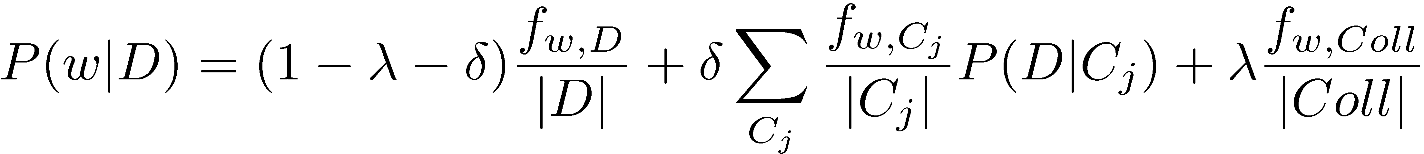
Clustering and Search
Cluster hypothesis
  “Closely associated documents tend to be relevant to the same requests” – van Rijsbergen ‘79
Tends to hold in practice, but not always
Two retrieval modeling options
  Retrieve clusters according to P(Q | C_{i})
  Smooth documents using K-NN clusters:
Smoothing approach more effective

Slide 65
Testing the Cluster Hypothesis

